Slide 1
IHTTPClientFactory and Polly
January 2020

Slide 2
Agenda
IHttpClientFactory
Polly

Slide 3
Why we need IHttpClientFactory?
Microsoft launched the HttpClient in .Net 4.5
It became the most popular way to consume a WebAPI HTTP request such as Get, Put, Post and Delete in your .net application.
Problems with HttpClient:
Doesn't dispose of the socket as soon as it is closed.
Each new HTTPClient object creates a new socket instance.
May lead to Socket exceptions.
Too many instances open affecting the performance.

Slide 4
IHttpClientFactory
In .Netcore 2.1, Microsoft introduced HttpClientFactory that solves all these problems.
Benefits:
Provides a central location for naming and configuring HttpClient instances.
Integrates with Polly for transient fault handling.
Manage the lifetime of HttpMessageHandler to avoid the problems that can occur when managing HttpClient lifetimes yourself.
Three ways to use IHttpClientFactory:
Direct HttpClientFactory
Named Clients
Typed Clients

Slide 5

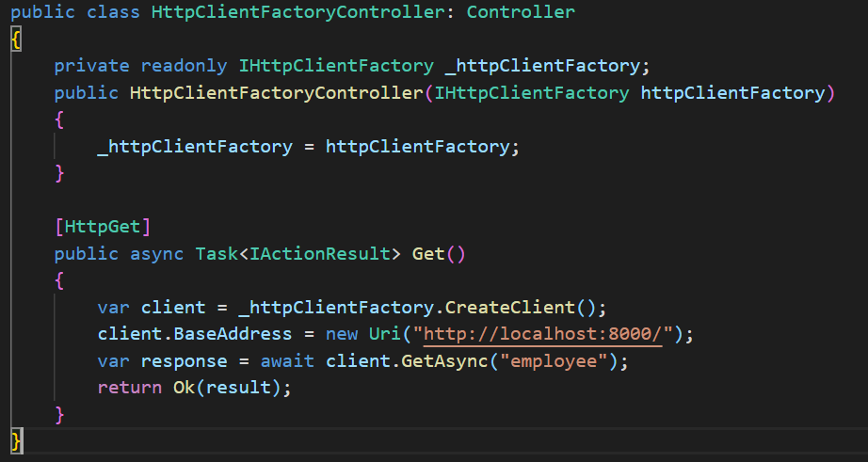
Direct HttpClientFactory
So for HttpClientFactory we need to register HttpClient like below:
In our API controller:

Slide 6
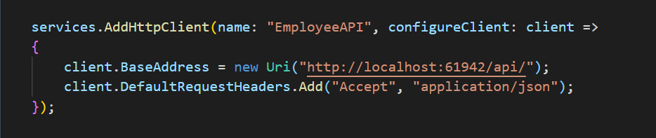
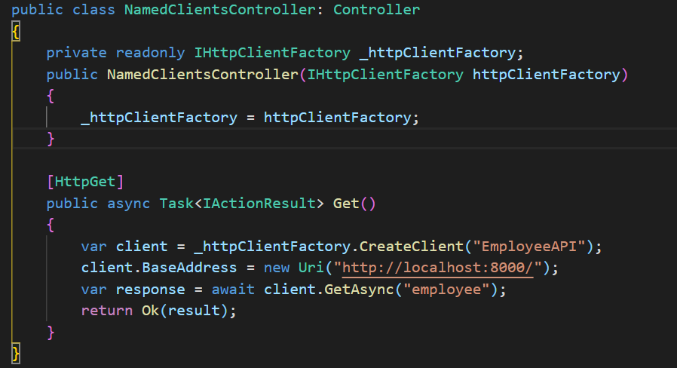
Named Clients
Useful when we need to make multiple requests from multiple locations:
We can use the named client in the API controller in this way:

Slide 7
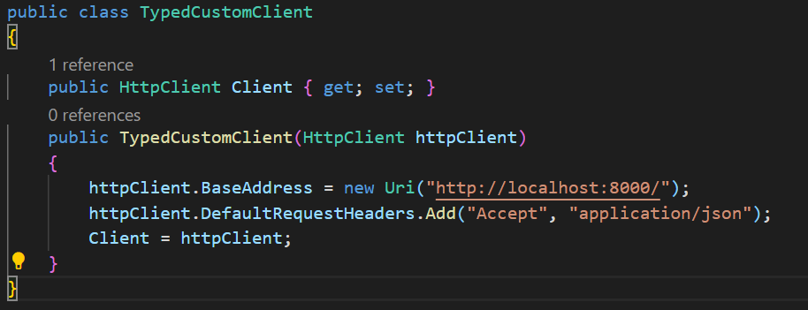

Typed Clients
Provides same capabilities as named clients but without the need to use string as keys in configuration.
Defined custom class for httpclient:
Now we can register this as a typed client using in this way in startup.cs class under configureService method:

Slide 8
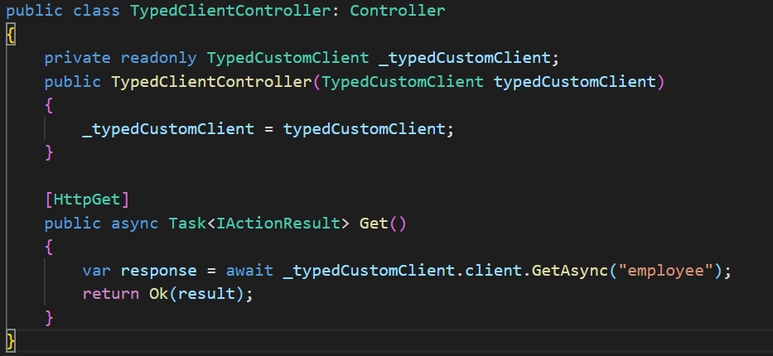
Typed Clients
Use it in API Controller:

Slide 9
Agenda
IHttpClientFactory
Polly

Slide 10
What is Polly?
Polly is a resilience framework for .NET available as a .NET Standard Library so it can run on your web services, desktop apps, mobile apps and inside your containers—anywhere .NET can run.
With only a few lines of code, Polly can retry failed requests, cache previous responses, protect your resources, prevent you from making requests to broken services, terminate requests that are taking too long and return a default value when all else fails.

Slide 11
Installing via Nuget
Install-Package Polly
Install-Package Microsoft.Extensions.Http.Polly
Install-Package Polly.Caching.Memory

Slide 12
Resilience Policies
Polly offers multiple resilience policies:
Retry
Circuit-breaker
Timeout
Fallback
PolicyWrap
Cache
Bulkhead Isolation

Slide 13
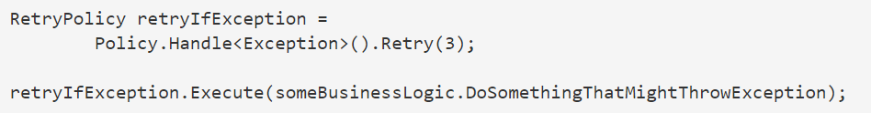
Retry
The Retry policy lets you retry a failed request due to an exception or an unexpected or bad result returned from the called code.
It doesn’t wait before retrying.
Lets you define how many retries should occur before it gives up.

Slide 14
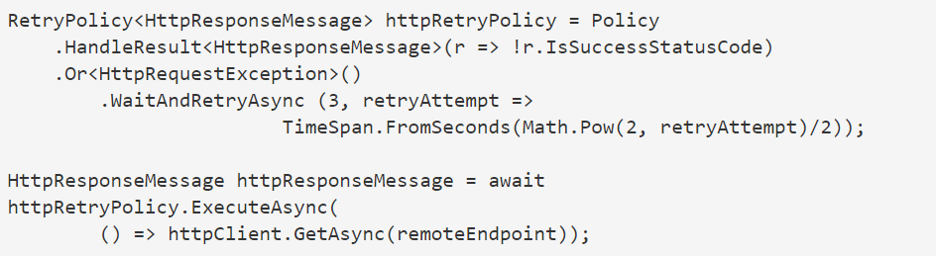
Wait and Retry
The Wait and Retry policy lets you pause before retrying, a great feature for scenarios where all you need is a little time for the problem to resolve.
It also takes one extra parameter: the delay to add before each retry.

Slide 15
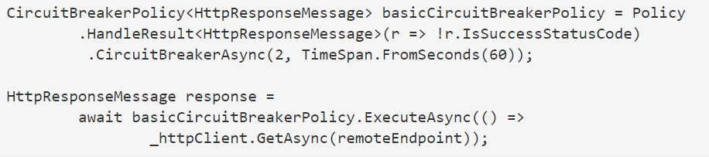
Circuit Breaker
If a method you’re calling or a piece of infrastructure you depend on becomes very unreliable, the best thing to do might be to stop making requests to it for a moment.
The Circuit Breaker policy lets you do this.
Polly offers two implementations of the circuit breaker: the Basic Circuit Breaker and the Advanced Circuit Breaker.

Slide 16
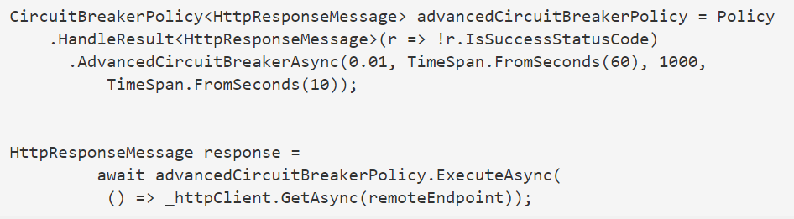
Advanced Circuit Breaker
Breaks when a threshold of faults occur within a time period, during which a high enough volume of requests were made.

Slide 17
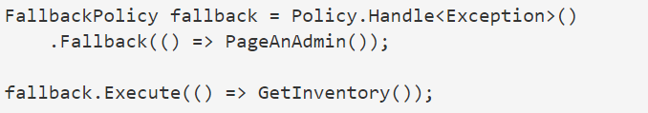
Fallbacks
The Fallback policy lets you return some default or perform an action.
Fallbacks are generally used in combination with other policies like Retry or Wait and Retry inside a wrap.

Slide 18
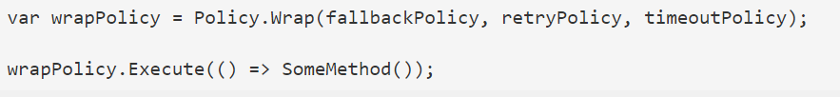
Policy Wraps
When you want to use polices together, use a Policy Wrap.
Wraps allow any number of policies to be chained together.

Slide 19
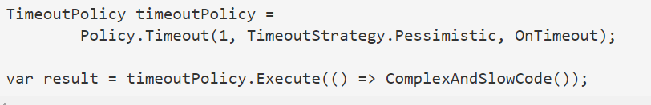
Timeout
The Timeout policy lets you (the caller) decide how long any request should take.
If the request takes longer than specified, the policy will terminate the request and cleanup resources via the usage of a cancellation token.

Slide 20
References
Use IHttpClientFactory to implement resilient HTTP requests
Polly Github
Implement HTTP call retries with exponential backoff with Polly

Slide 21
Thank You
ct-univerct@citiustech.com

